Slide 1
Vehicle

Slide 2
Introduction
The PhysX Vehicle SDK models vehicles as collections of sprung masses
where each sprung mass represents a suspension line with associated wheel and tire data
These collections of sprung masses have a complementary representation as a rigid body actor whose mass, center of mass, and moment of inertia matches exactly the masses and coordinates of the sprung masses

Slide 3
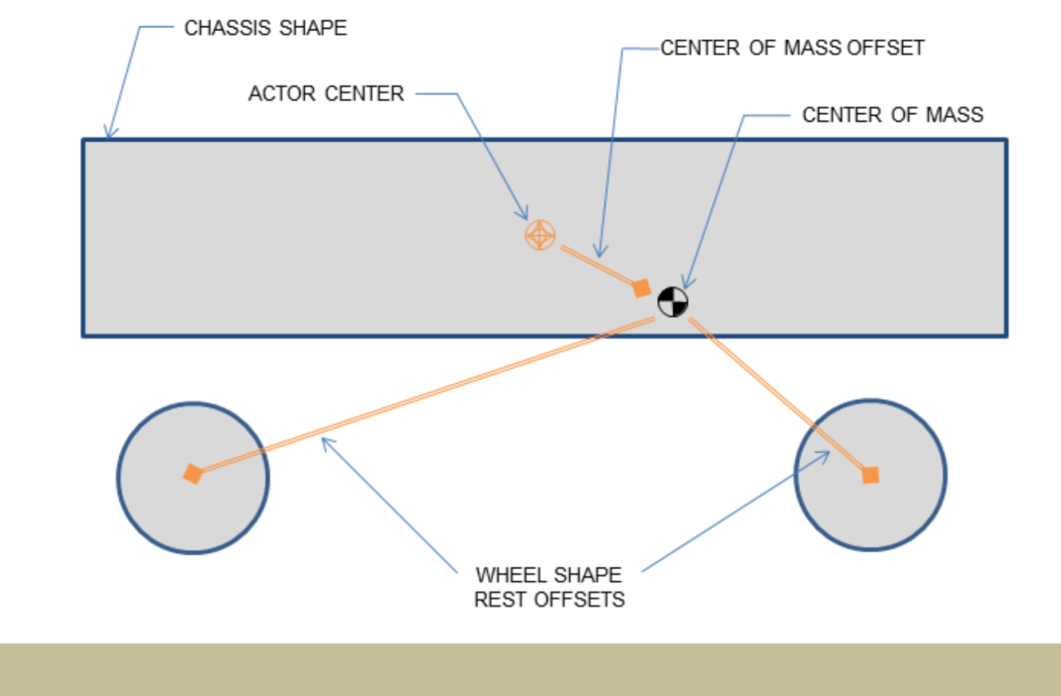
Vehicle representation as a rigid body actor with shapes for the chassis and wheels. Note that the wheel rest offsets are specified relative to the center of mass.

Slide 4
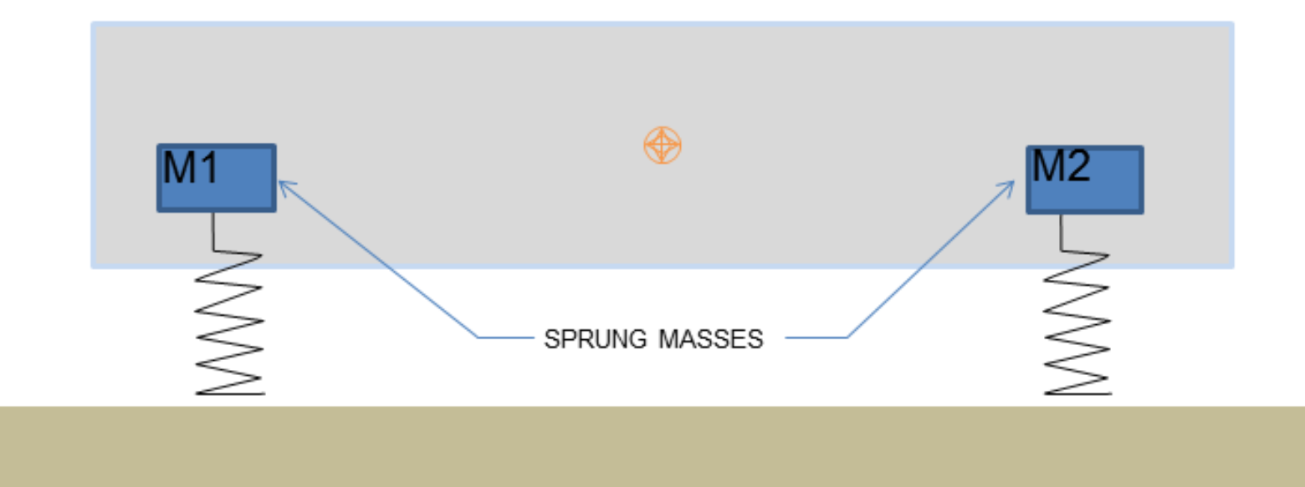
Vehicle representation as a collection of sprung masses of mass M1 and M2.

Slide 5
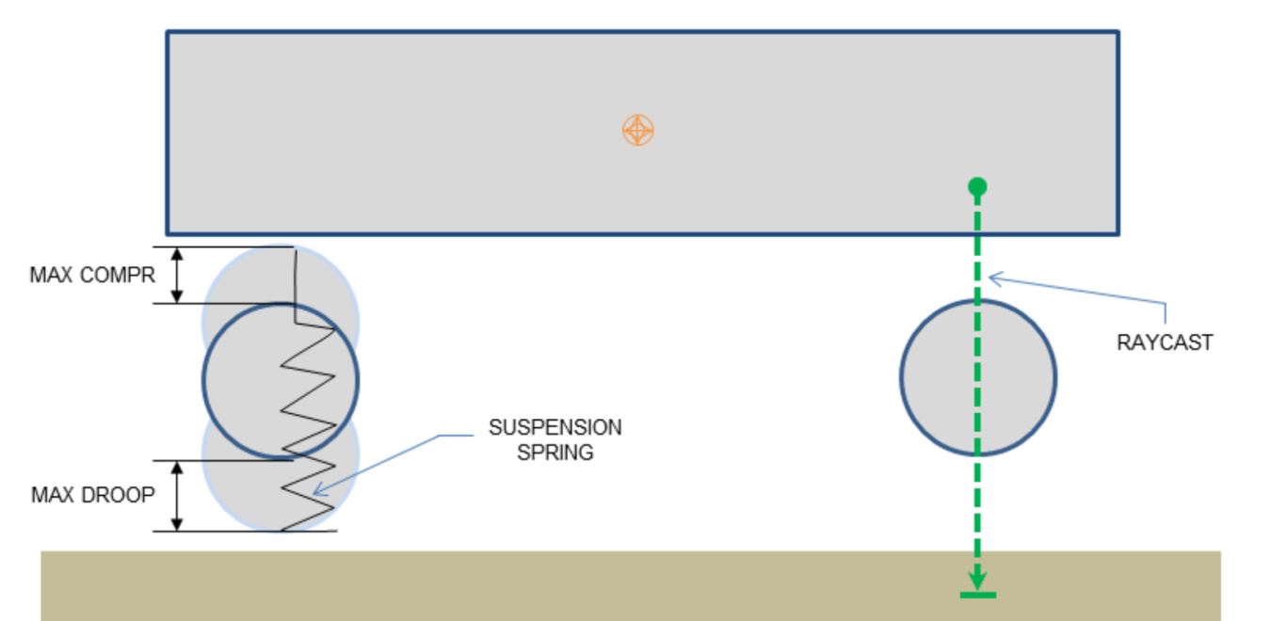
The update of each vehicle begins with a raycast for each suspension line. The raycast starts just above the the top of the tire at maximum compression and casts downwards along the direction of suspension travel to a position just below the bottom of the tire at maximum droop

